Slide 1
UI Design Strategies
BWSI-SGAI
Summer 2021
Notes:
Partner everyone before class begins
Comprehensive and overwhelming – slides as a reminder of where to start
1” deep, mile wide

Slide 2
Summary
User Interface design is hard to get right and easy to get wrong
A bad UI can be very costly (literal and figurative)
UI design spans several spaces:
Stakeholders
Functionality
Platform
Connectivity
Security
As a UI dev you can expect:
That everyone else is an expert
Most suggestions and advice are conflicting
Infinity +1 demands for last minute changes
Notes:
This presentation will help with these challenges

Slide 3
Outline
What is User Interface?
How do you build a winner?
Quantitative and qualitative design guides
5 Points for a solid design
Developing mockups
Software project management
User stories and use cases
Best practices
Notes:
Overwhelmingly large topic, take a tactical approach

Slide 4






The Five Senses

Slide 5
User Interface Defined
The user interface [..] is the space where interaction between humans and machines occurs
The goal is:
effective operation and control of the machine
feedback from the machine
for the purpose of making operational decisions
UI development relies primarily on 3 senses: vision, touch, hearing
Boundaries have blurred: voice input vs touch input, tactile feedback vs visual feedback, touch screens, etc.
As UI’s become more sophisticated the machine assumes more control and function from the user
- Wikipedia
Notes:
HMI, MMI
CLI (cmd), Gesture, Motion Tracking, Task-Focused, Natual-lang, Web, etc.

Slide 6
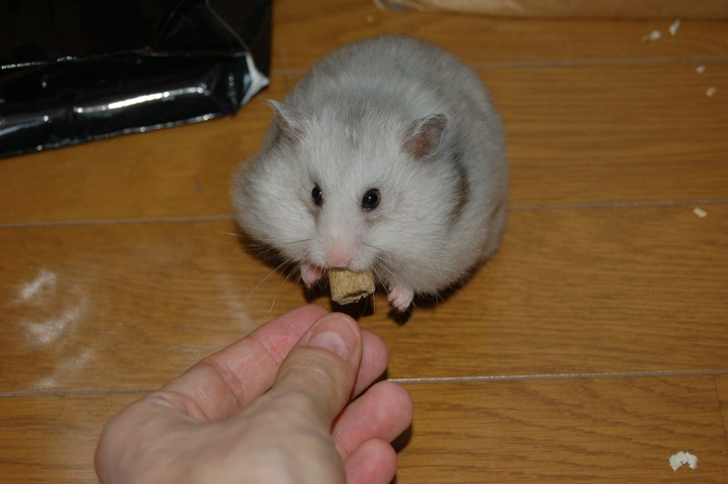


Goal of UI Design
Notes:
Why should a UI be pleasing?
Add popup animation with sound
Replace kibble with candy

Slide 7
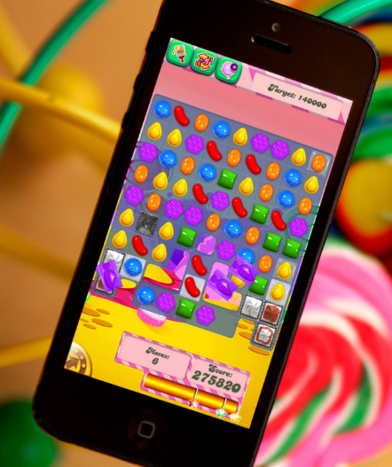

Example of UI Success
How Successful?
$650,000/day
500 million downloads (11/13)
Notes:
45% consider themselves “casual gamers”

Slide 8
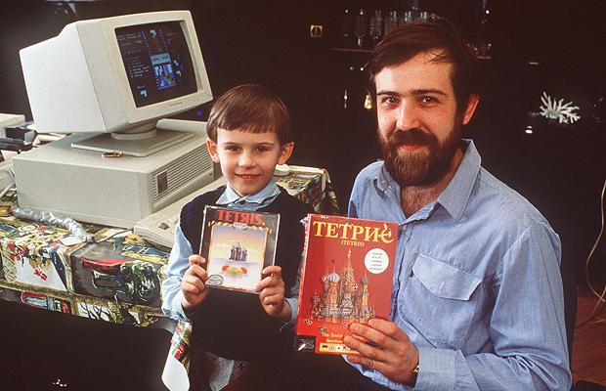
So How Do You Build A Winner?
Hard to explain how to create a super-nova of wonderful, however there are certain basic principles to adhere to, and certain ones to avoid.
Notes:
Time travel…
Each example explain mechanic and objectives

Slide 9
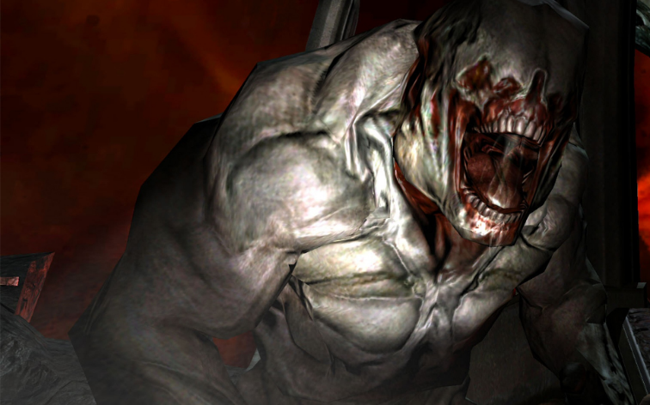
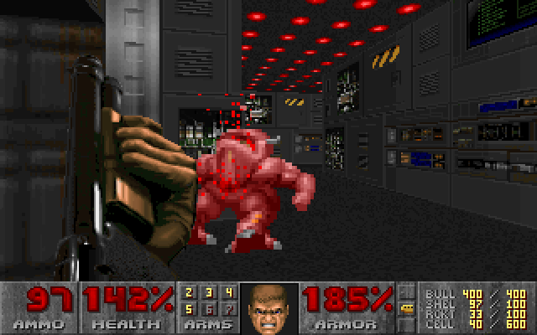
Winner #1
Notes:
Distinguish content from presentation
“pseudo-3D first-person perspective giving environments a spatial representation that has a major effect on the level design and gameplay experience.^{[4]”}
The objective of each level is simply to locate the exit room that leads to the next area, marked with an exit sign and/or a special kind of door, while surviving all hazards on the way
The development of Doom started in 1992, when John D. Carmack developed a new 3D game engine,
1993 – 50 WWW servers, NT is released, WinRAR released, NVIDIA founded, 486, NeXT shuts down (pre Power-Mac) HW: 4MB Ram, 1024x768 screen, 512k VRAM, 80MBdrive, 14” monitor

Slide 10
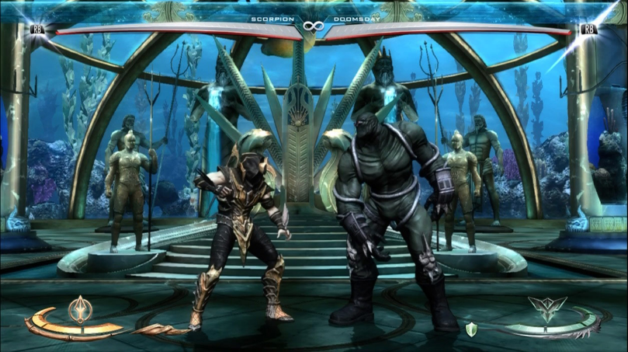
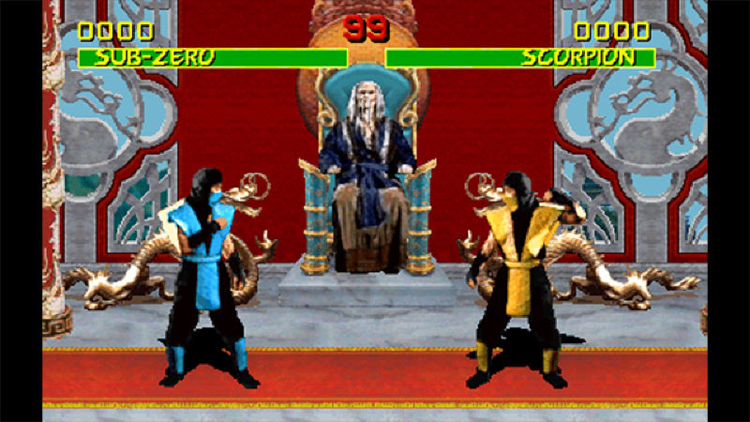
Winner #2
Notes:
Joystick and 5 buttons (not counting start)
Awareness of more than just graphics
1992, originally arcade form, 1996, side scroller, pvp

Slide 11
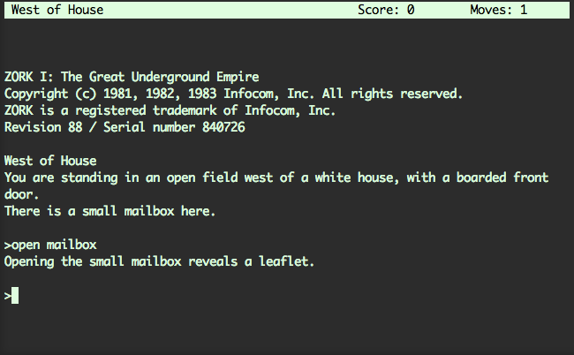
Winner #3
Notes:
Zork
1981, 16kB Ram, 0.6MHz, 5” CRT Display, IBM Hires Gates and Allen to create DOS, languages: BASIC, FORTRAN, Pascal, COBOL
Atari registers copyright for Asteroids and Lunar Lander
Jeff Dailey, a 19-year old becomes the first person to die from computer gaming after dying from a heart attack after posting a score of 16,660 on Berzerk.
Satya Pal Asija receives the first U.S. patent for a computer software program May 26, 1981.
Did you see what I did there?

Slide 12
Exercise #1
Describe in brief detail:
The 3 most important things you consider when designing any kind of software
The 3 things you consider when buying software (for yourself or someone else)
Select one from each category
Draw a correlation between the two factors and summarize it briefly
Example: I buy games to play cooperatively with my friends
Top design consideration: connectivity
Correlation: Good connectivity is key because online experience is more important than graphics or plot

Slide 13
Quantitative vs. Qualitative Design Guides
Human Factors:
ANSI/HFES 200 - Human Factors Engineering of Software User Interfaces
MIL-STD 1472 F : DEPARTMENT OF DEFENSE DESIGN CRITERIA STANDARD HUMAN ENGINEERING
The purpose of this standard is to present human engineering design criteria, principles, and practices to be applied in the design of systems, [..] so as to:
a. Achieve required performance by operator, control, and maintenance personnel.
b. Achieve required manpower readiness for system performance.
c. Achieve required reliability of personnel-equipment combinations.
Windows (8) or Apple (4) UI Design Guidelines and Principles
Reduce concepts to increase confidence
Solve distractions, not discoverability
Attention to detail
Notes:
Hard and soft constraints (hard = quantitative, soft = qualitative)
Look at two factors in UI design: 1. layout and 2. response time
What external (hardware/network/user) attributes can influence these factors?
Explain a UI factor that can impact performance

Slide 14
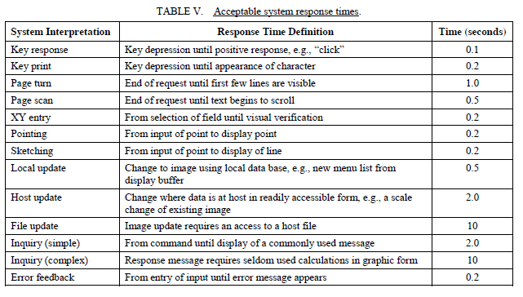
MIL-STD-1472G: Response Times

Slide 15
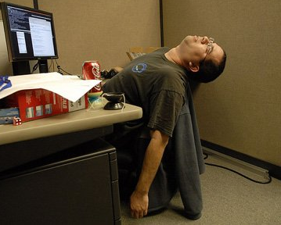
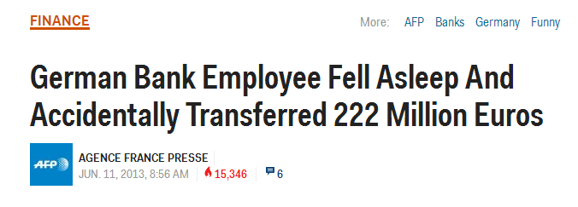
Impact of Response Times
0.1 second - the user feel that the system is reacting instantaneously
1.0 second - the user can stay focused, but notice a delay
10 seconds - about the limit for keeping a user's attention
For longer delays, users will want to perform other tasks while waiting for the computer to finish:
Provide feedback when done
Support loss of focus
Source: JAKOB NIELSEN, Usability Engineering, 1993

Slide 16
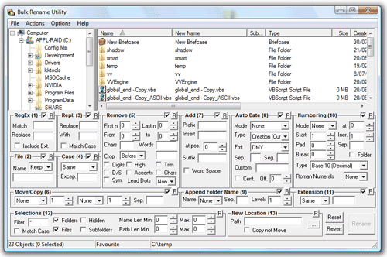
Do But Don’t Overdo
Notes:
How could this be improved?
How many people play games?

Slide 17
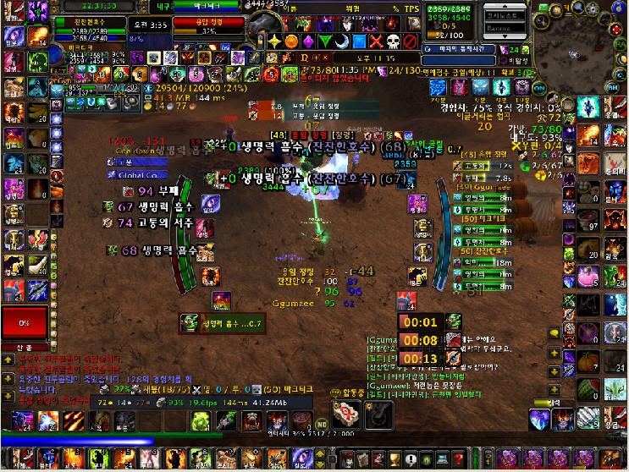
Really We Mean It
Notes:
How many people drive cars?

Slide 18
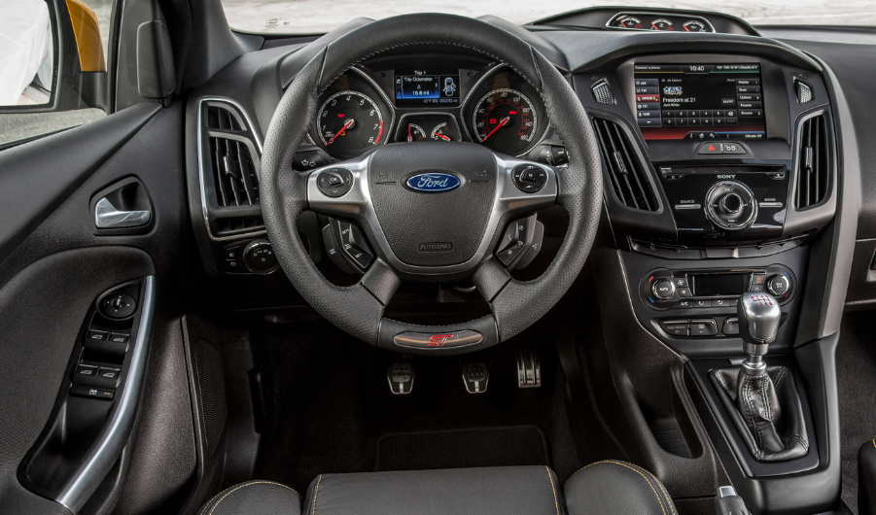
No Seriously
Notes:
2013 Ford Focus
What’s good? What’s bad?
Car is over heating
Car is playing country music
Car is foggy
Car has lights left on
What is that?

Slide 19
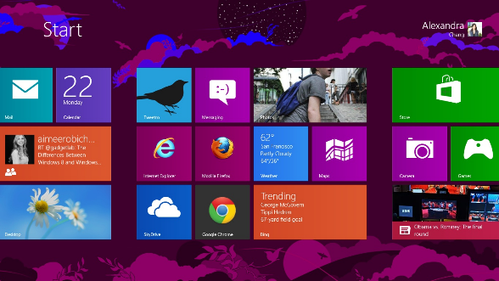
Exercise #2
Windows 8 was released August 2012
Attempt to create a unified look and feel between tablets and PC’s
Discuss: Was it a success or failure?
Notes:
Win 8, Concept
Hand out windows 8 UX categories
Windows User Experience Design Principles
Reduce concepts to increase confidence
Have you introduced a new concept? Why? Is it necessary?
Can you get rid of unneeded concepts?
Are you making meaningful distinctions?
Does the UX continue the same concept?
Small things matter, good and bad
What are the important "small things" seen often or by many?
What small problems are you solving?
Do less better.
Don't cut the small things in your experiences.
Plan for the thoughtful details.
Fix the small bugs.
Be great at "look" and "do"
What is your UX great at? Does its look reflect what it is great at?
Does the first thing users see reflect what the UX is great at?
Does the UX match expectations?
Is it obvious what users can do?
Are you providing only the necessary steps?
Solve distractions, not discoverability
Reduce distractions.
Don't let features compete with themselves.
Commit to new functionality.
These are not solutions to poor discoverability:
Pinning an icon in the Start menu.
Putting an icon on the desktop.
Putting an icon in the notification area.
Using a notification.
Having a first run experience.
Having a tour.
UX before knobs and questions
Turn down the volume of questions.
Ask once.
Don't require configuration to get value.
Was the question asked already?
Look for opportunities to consolidate.
Personalization, not customization
Does the feature allow users to express an element of themselves?
Have you made the distinction between personalization and customization?
Does the personalization have to be a new feature, or can it make use of existing features and information (such as the user's location, background picture, or tile)?
Value the life cycle of the experience
Consider the user experience at all stages:
Installation and creation.
First use and customization.
Regular use.
Management and maintenance.
Uninstall or upgrade.
Walk through the experience as if it has been used for 12 months. Does it have:
Realistic content.
Realistic volume.
Time matters, so build for people on the go
All UX principles apply equally at 12-inch and 20-inch screen sizes.
Be interruptible.
Account for starting and stopping (fast return, and do not get in the way of other UX).
Account for getting and losing connectivity.
Performance is the universal UX killer.

Slide 20
5 Points For A Solid Design
Going out of your way to ensure stakeholder involvement
Not just involvement but investment, these are your evangelists
Being completely clear on your functionality
How well can you characterize you data?
Know your deployment platform
Hardware and software limitations, capabilities
Coping with connectivity (or lack thereof)
If you need internets what happens with poor connectivity?
Ensuring user security
Data is vulnerable with every keystroke, what are the users expectations of privacy? How much value is at stake?

Slide 21

Stakeholder Investment
As with everything stakeholder investment is critical
Most successful projects have an evangelist
Objective: convince SME’s that you are:
Here to help them
Open to their input
Responsive to their needs
Not trying to tell them how to do their job or worse…
Not designing them out of a job
Games can help because they:
Break barriers
Provide alternative ways of thinking
Less pedantic
Team builders

Slide 22
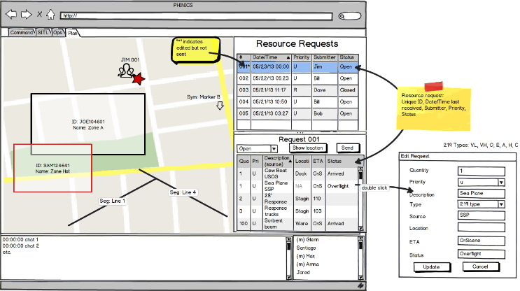
Paperdolls
Mockup tools provide significant value
Visualize and discuss prototype impact on SOP/CONOPS

Slide 23
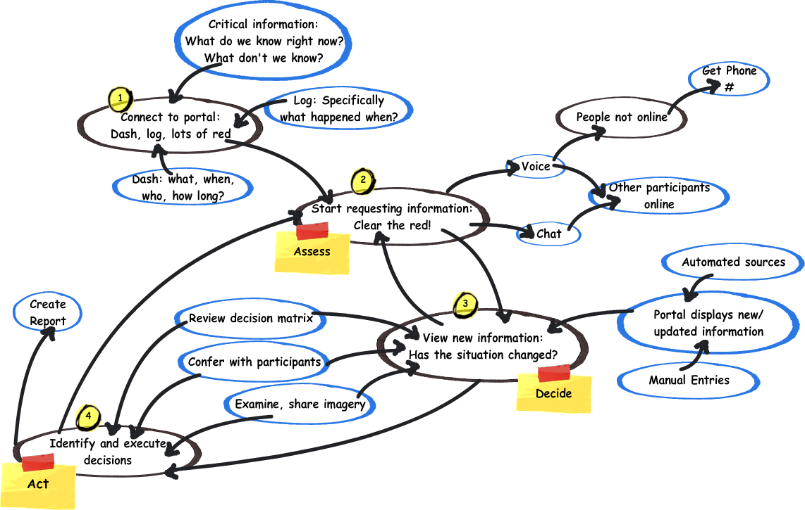
Sketch Focuses Attention on Content
Notes:
Collaboration, Brainstorming, Low-learning curve

Slide 24
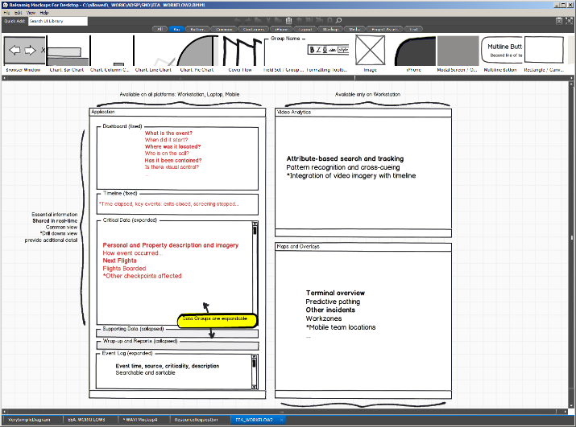
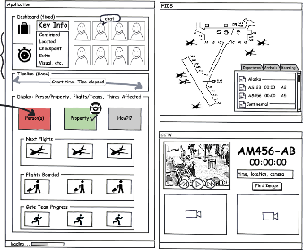
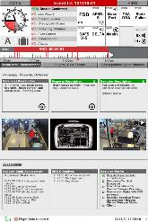
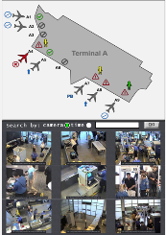
Tool Example: Balsamiq Mockups
Notes:
http://balsamiq.com/

Slide 25
Side Track: Cost/Effort Assessment
Question 1: How well can you estimate the level of effort to develop software?
Manpower
Schedule
Modules / Components
SLOC
Questions 2: What about for UI?
Question 3: Name some of the risk factors involved
Final Question: What methods can you use for cost estimation?
Poor cost estimation can have a major impact on your UI design
Notes:
ACA roll-out

Slide 26
Function Point Analysis
FPA is all about data :
Crossing application boundary
Stored internally
Stored externally
Function point types:
External Input (EI)
External Output (EO)
External Query (EQ)
External Interface File (EIF)
Internal Logical File (ILF)
Adjustment for data complexity:
Data/Record/File Element Type

Slide 27
Simple UI Function Point Example
What is the (raw) complexity of this UI?
db
Project Set-up
Project name:
Project number:
Project description:
Department name:
Department number:
Team number:
Team lead:
A record
Add
Change
Delete
Cancel
+1 for each data element displayed (EO)
+1 transaction x # data elements (EI)
+1 for each record read/referenced (FTR)
1 (record read:FTR) + 2x8 (record add/change:EI) + 7 (entries:EO) + 1x2 (record delete:EO)
Notes:
Think in terms of data: going to/from user, going to/from database
Also – number of records that need to be searched for this data (e.g. how many tables are touched?)
Add one if there is a response to user
Next step is to estimate complexity
Total: 26

Slide 28



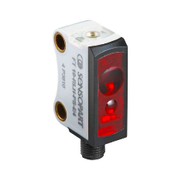
Know Your Platform Like You Know Your Users
$
$$
$$$
Think “Data Centric”
What data is coming into the system?
Format? How fast? How accurate? How important?
What data does your user need to see?
Format? How fast? How accurate? How important?
Notes:
Prioritize for the user, abstract from “how things are done” to “how they will be done” [e.g. CLI vs Object]
Poor assumptions can have a major impact
Obsessing with less important, less accurate data can waste precious time vs. the opposite

Slide 29
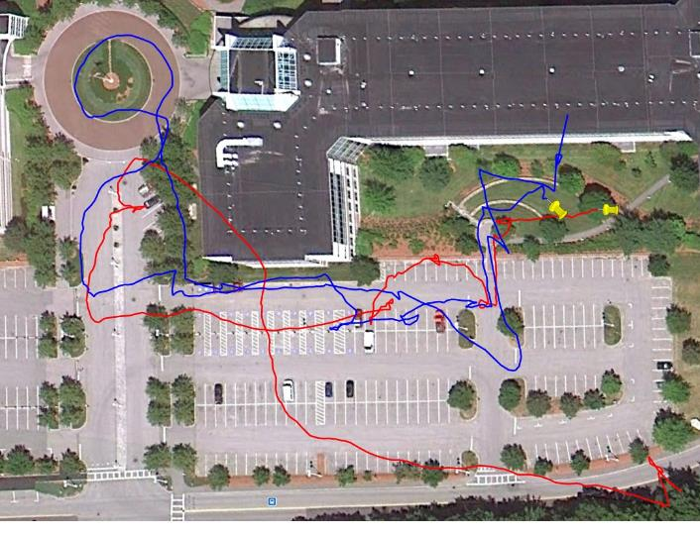
Be Prepared For Surprises
Side by side: Same devices, different results

Slide 30
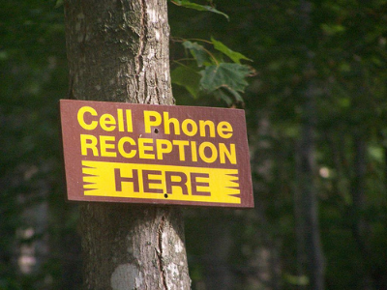
Know Your Dependencies
Identify show stoppers up front
Call these out in your requirements
Explicitly define interfaces and identify data items
Type, range, frequency, quantity, error
Test with your actual equipment at actual location
Notes:
True for more than just mobile devices
However challenges often produce good technology advances

Slide 31
Connectivity
Increase in client-server architectures
Availability of internet
Greater power with greater portability
Lighter weight, more emphasis on mobility for both sensors and computers
Greater integration
UI’s are becoming increasingly dependent for external data input
But what happens when connectivity is lost?
What is the impact on the user?
How can this be mitigated?
Alternatively, how can you get users to “dial back” their usage?
Why would this be necessary?
Notes:
Cell phones have a multitude of sensors – past: music, photo, gps, phone, altim, pedo, etc.
mmos

Slide 32
User Stories
"As a <role>, I want <goal/desire>”
Examples:
"As a mobile user, I want to get SA when I’m in danger"
"As an sys admin, I want to set access rights for users"
"As a decision maker, I want to facilitate C2 reporting"
User stories are an Agile method for rapidly capturing requirements
User Stories illustrate how a system works from end-user perspective
Example narrates type of user stories we hope to collect

Slide 33

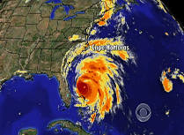
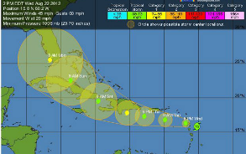
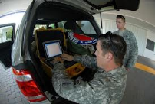
User Story Example
A major hurricane has hit
Refugees are being evacuated
Communications, both wired and wireless are limited
Volunteers from neighboring communities are coming to help
User Story: Illustrate how mobile devices can provide a process to organize and track volunteers, reducing logistical burden
Notes:
Discuss other user stories: “Bob Supervisor”

Slide 34
System Design and UI Requirements

Slide 35
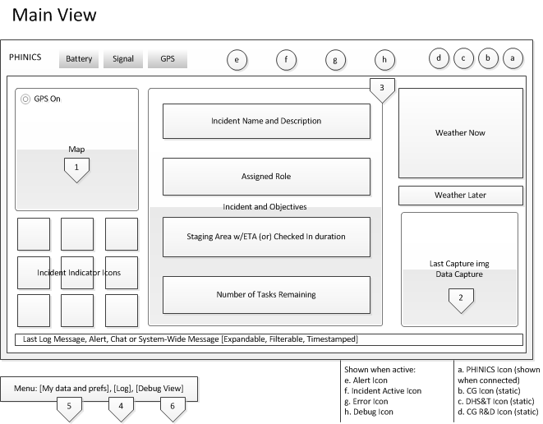
Map to Wireframe

Slide 36
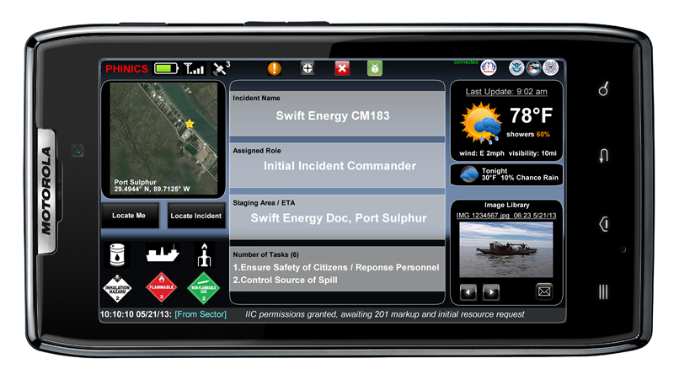
Sponsor Review Glossy

Slide 37
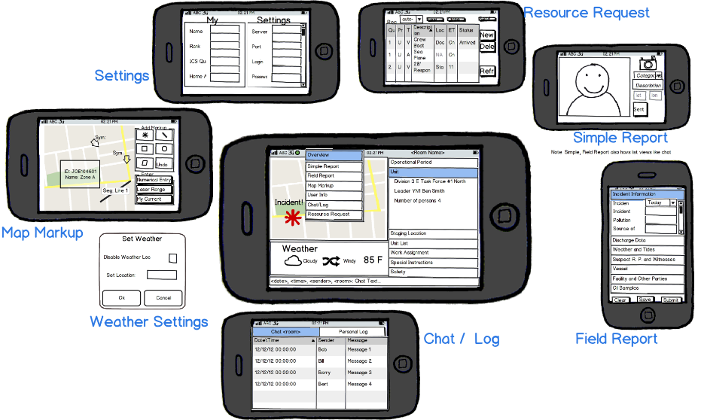
Feedback Into Wireframes

Slide 38
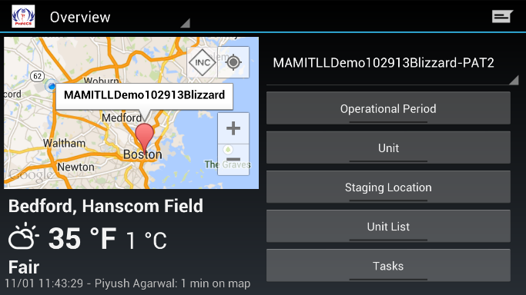
Final Design

Slide 39
Packaging and Presenting
Know your audience
Make certain your audience is prepared and receptive
Message: “We value your input, we will act on your suggestions”
Practice, practice, practice
Thoroughly test your demo
Best part is practice also doubles as QC/QA
Consider all eventualities
Will you have connectivity?
Will your laptop/projector work?
Backup and backup for backup
If you’re client/server think about running both on the same machine
Always bring slides just in case
Lock down code and server well BEFORE you demo
Notify your colo or host of your demo in advance
Notes:
Slides are handy – hand out and mark up

Slide 40
5 Rules of Damage Control (What to do when things don’t go as planned)
Rule #1 – You can NEVER have enough testing, so test as often with as many people as you can
Rule #2 – Things will always go wrong, so keep multiple configurations on hand
Rule #3 – Have a plan for how to present if there is: no power, no projector, no connectivity (slide handouts at the very least)
Rule #4 – Users who have been involved in the project from the start are typically very forgiving, if things don’t work just move on
Rule #5 – Set expectations properly, explain what to expect in the worst case before you present

Slide 41
Some Best Design Practices
UI Design can neither lead nor be left out of requirements development
Just like testing, UI should be included at all stages, including proposal
There’s no “mystique” to good UI development, you just need to know your domain users
Use: surveys, ride-alongs, site visits, tabletops, paper dolls, user stories, mockups and sketch up early and often
Develop a communication plan for your stakeholders before kickoff
Persistently demonstrate to users that you understand their concerns and show how their input contributes
Be wary of last minute changes
Screen-shot and document

Slide 42
Wrapup: How To Do UI’s “Not Wrong”
Participate in all phases, including early and late ones
Consider UI design during project definition to define scope
Understand your audience
Do one/all of the following: Talk to them, look at the data they use and how they currently manage it, role play
Get feedback early and often
Include UI sketches with requirements, design and *TEST*
Nail your interface before you complete design
Make certain you have the data you need in the format you need it
Play with paper-dolls
Use sketchup tools, web page builders, or just pencil and paper
Document
It’s for YOU not for THEM, you might need to remember someday

Slide 43
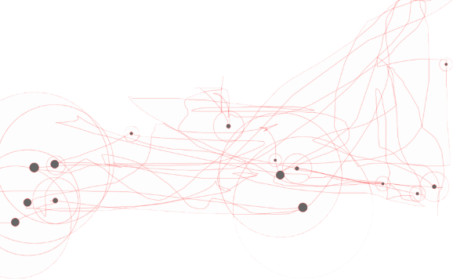
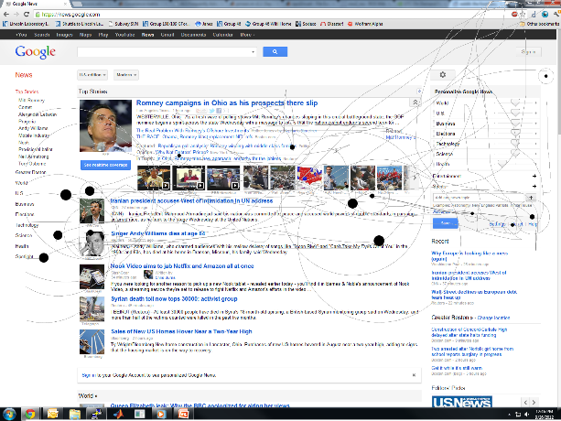
Software UI Evaluation
Mouse tracking to evaluate use of the UI.
Area of Interest
Clicks

